Slide 1
Phelan-McDermid Syndrome
by : Sumanth Pandiri, CJ Boni, and Yash Patel

Slide 2
What is Phelan-McDermid syndrome? & Our Goal
Phelan-McDermid syndrome (PMS) is a rare genetic condition that causes developmental and speech delays, behavioral problems and a weakened or no ability to feel pain or sweat.
Project Description:
The project goal is to identify significant differences between PMS((Phelan-McDermid syndrome) patients and control cell lines, identify candidate pathways that are particularly affected in individuals with PMS eventually, and identify subgroups within the PMS population based on their metabolic profiles. The data for this project was generated using the Biolog Phenotype Mammalian Microarrays: this technology measures the production of energy (NADH) in the presence of different metabolic compounds.

Slide 3
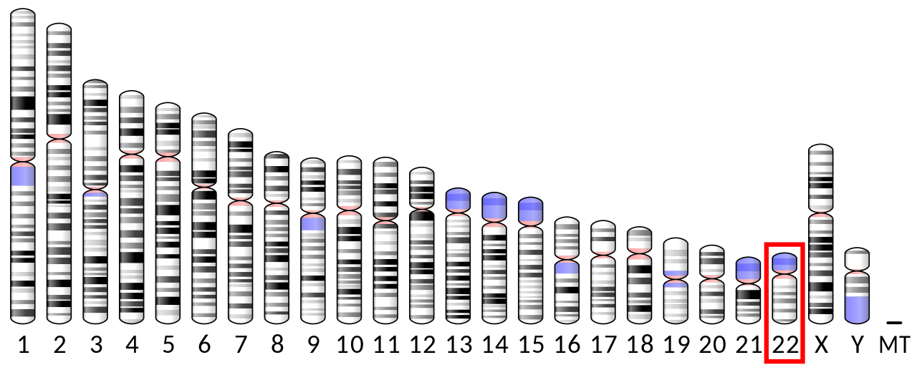
What & Why Did We Analyze?
The goal of our project is to use the endpoint absorbance of metabolic pathways in human cells to determine the presence of Phelan-McDermid Syndrome (PMS) in a subject
The cells used in the study were derived from the participants’ blood, and the endpoint absorbance of the cells was observed using the Biolog Phenotype Mammalian Microarrays. The dataset measures endpoint absorbance across 768 different wells, which tested various metabolic sources and effectors.
We were provided with normalized versions of the raw control and patient data, which is what we decided to use for this project. (using Pandas)

Slide 4
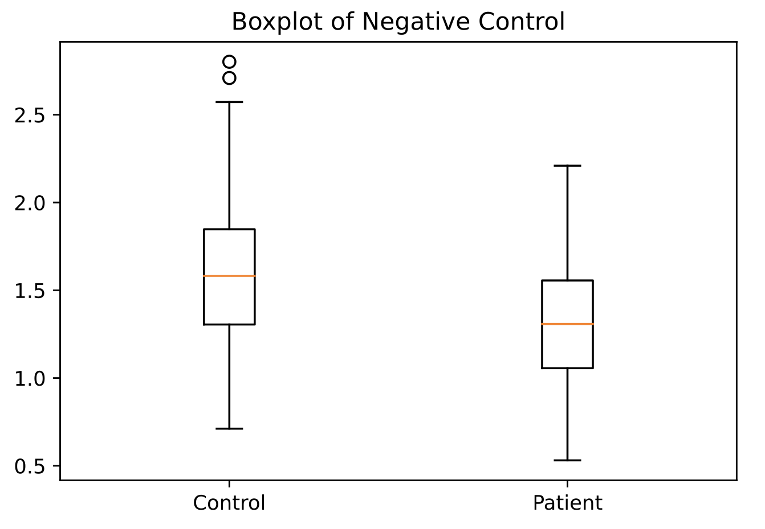
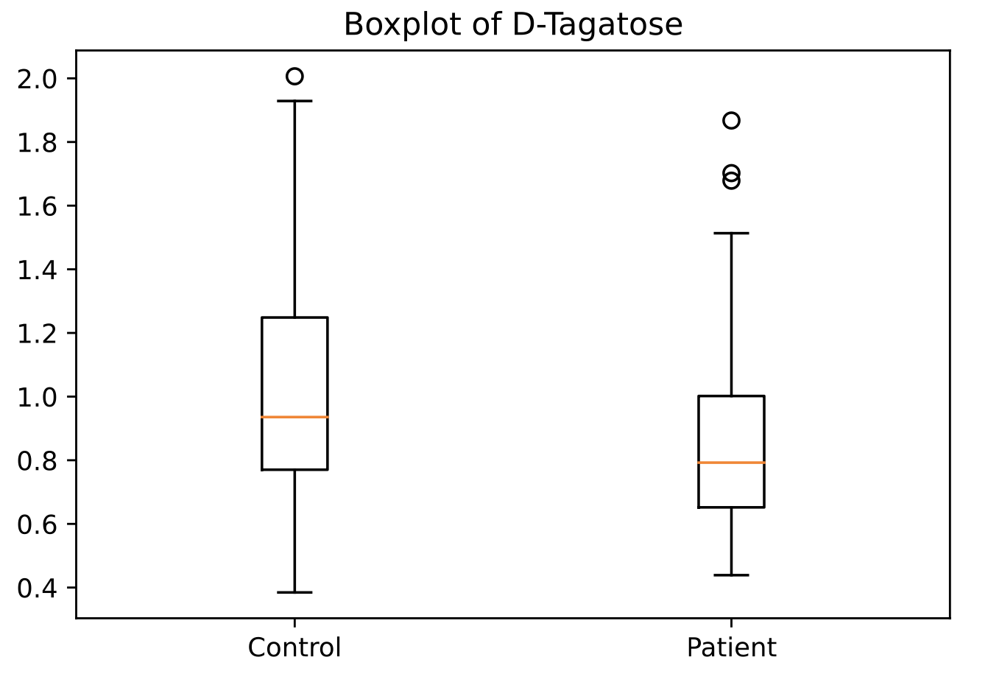
Exploratory Data Analysis
We began our preliminary data analysis by simply plotting boxplots for the patient and control data separately, across all the wells. Through these boxplots, we started to notice that there were differences in medians, typically with the control being larger in median than the patient. The pictures depict boxplots for 2 of the 768 wells.

Slide 5
Further Statistical Analysis
From the boxplot visualizations, we noticed that the control medians tended to be higher than the patient medians. We also noticed that there were a significant amount of outliers throughout the graphs
We decided to look at the median difference between the control and patient medians in each well, as well as the median difference between the control and patient means across each well.
Median difference in means across each well: 0.24432858029483007
Median difference in medians across each well: 0.2609712967231488

Slide 6
Visualizations
We decided to plot the median difference between the control and patient medians in each well, as well as the median difference between the control and patient means across each well. We also looked at the differences in IQR and Variance over each well. We noticed that there was a major outlier in wells 412-415, which were Manganese Chloride. For context, we plotted up to 411 in the second plot, and from 416 onwards in the 3rd plot.
Excluding Manganese Chloride:
Median difference in means across each well: 0.2409768834768401
Median difference in medians across each well: 0.2587385282494399

Slide 7
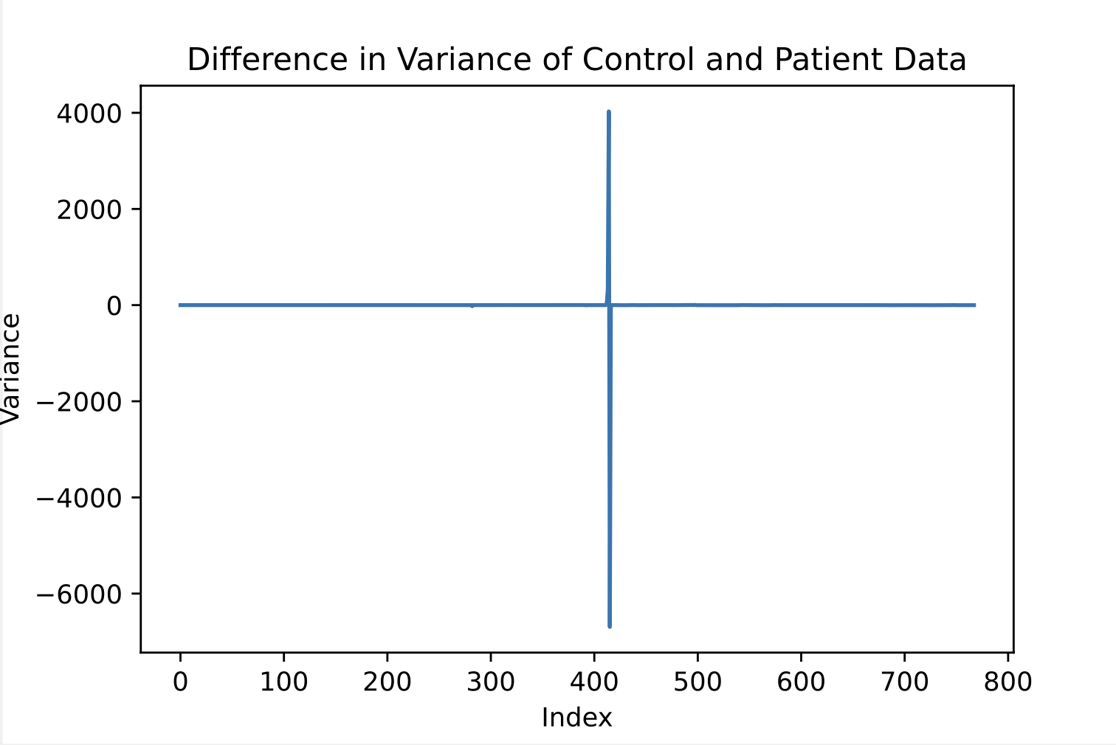
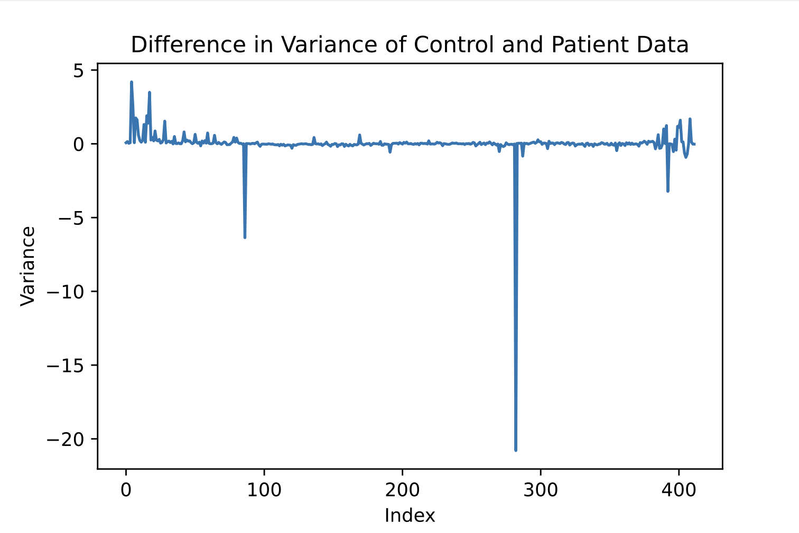
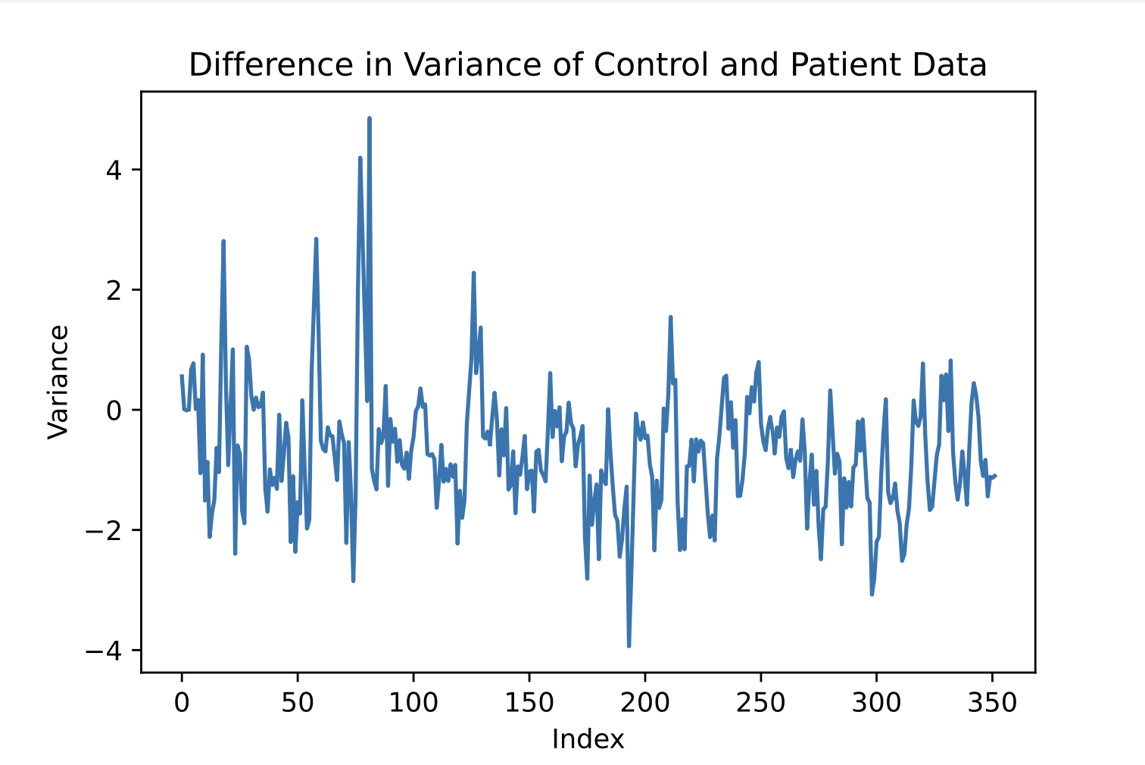
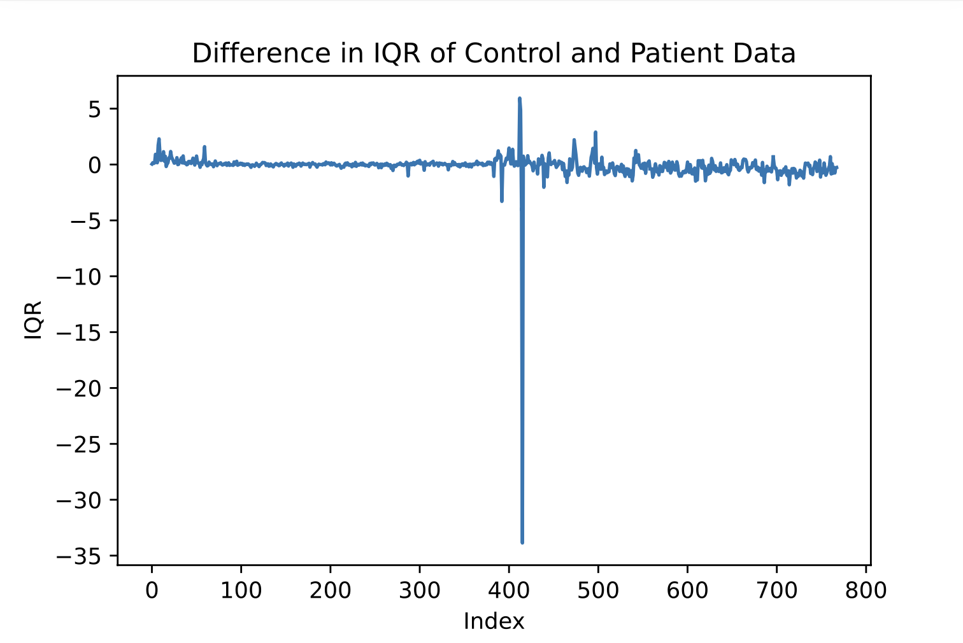
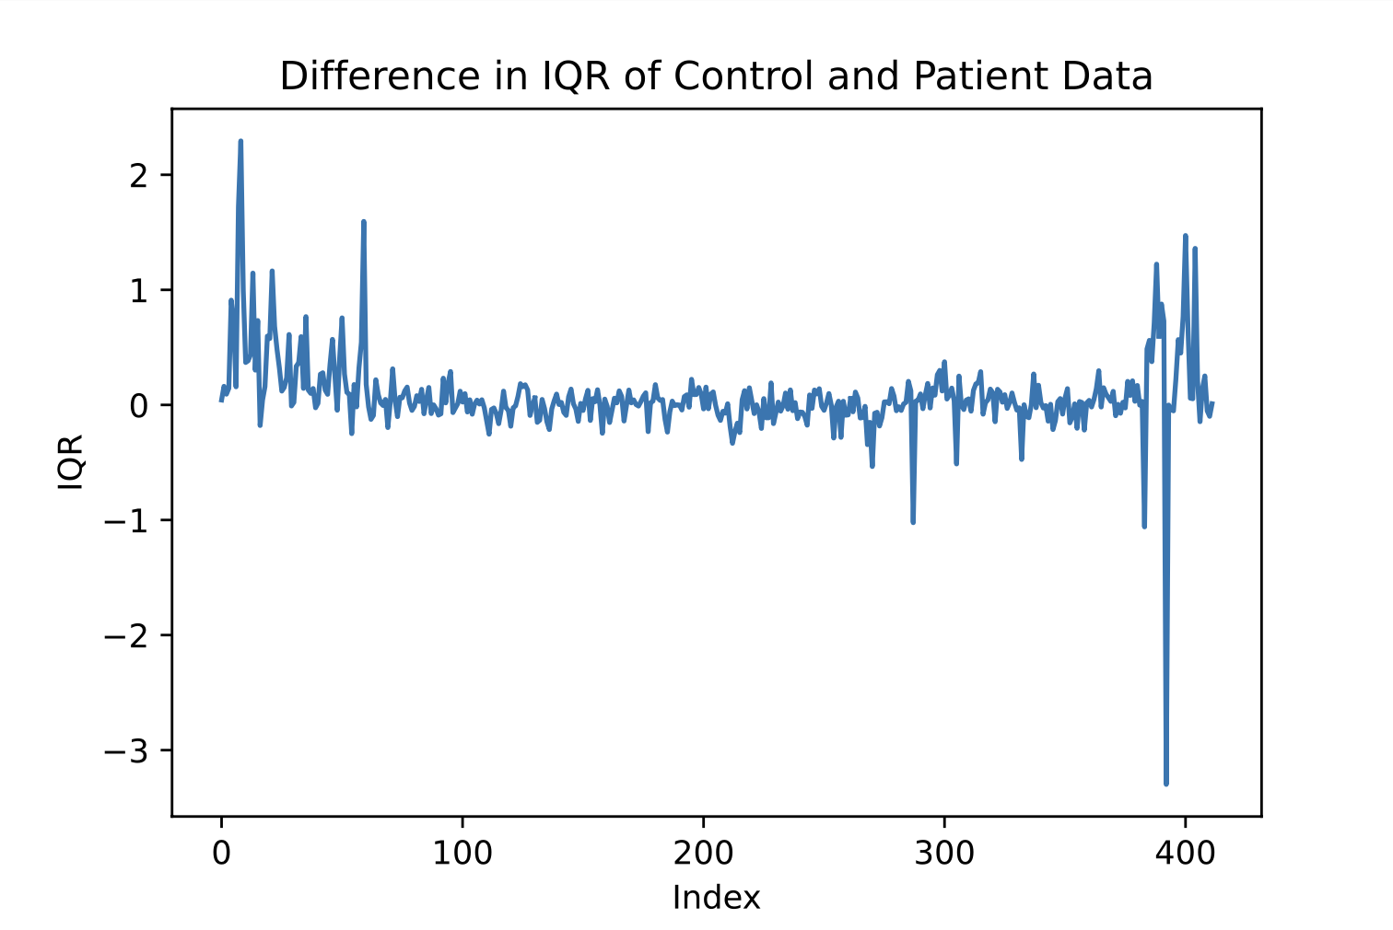
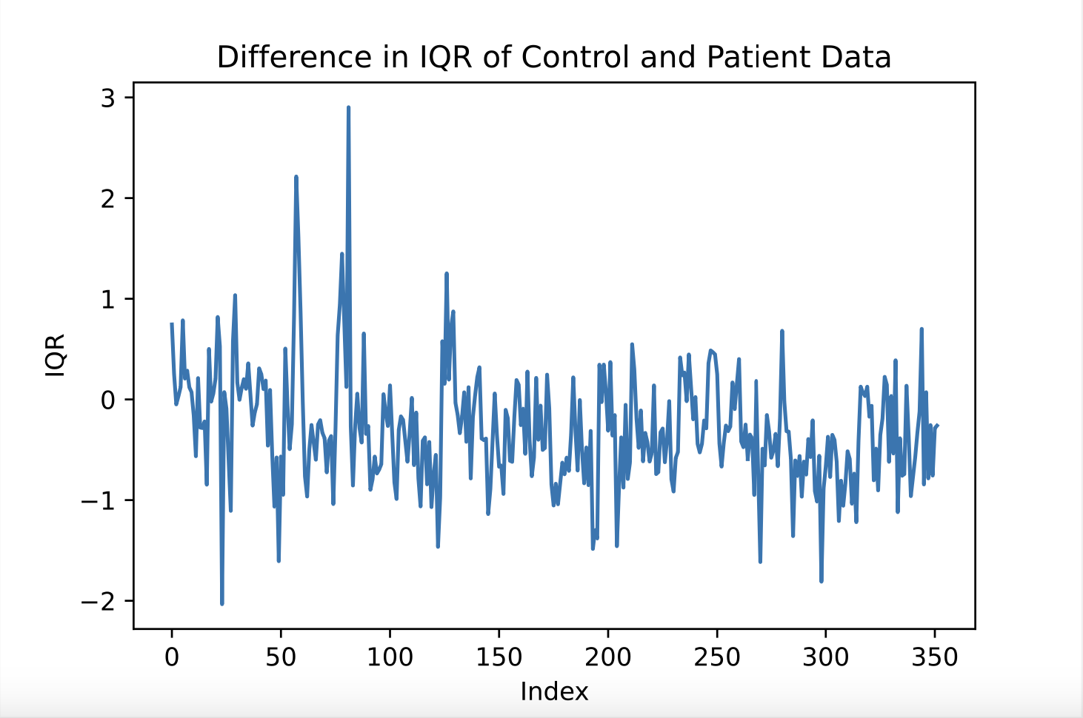
IQR and Median Visualizations

Slide 8
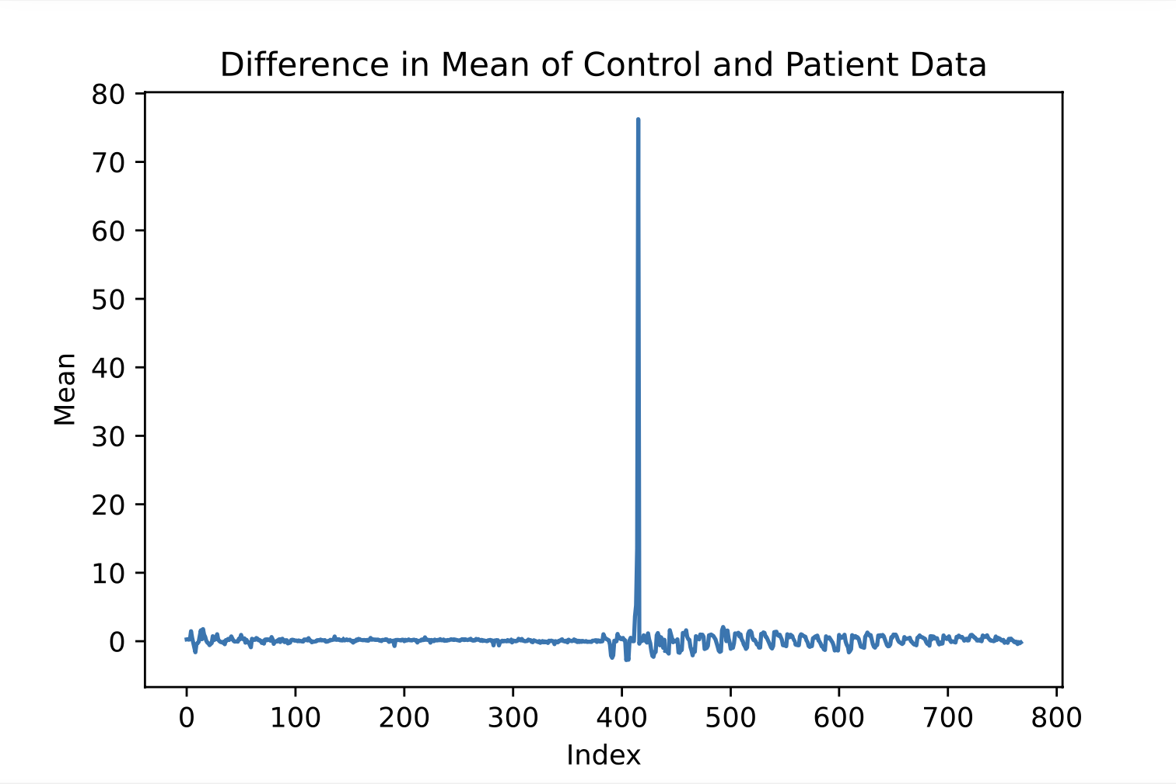
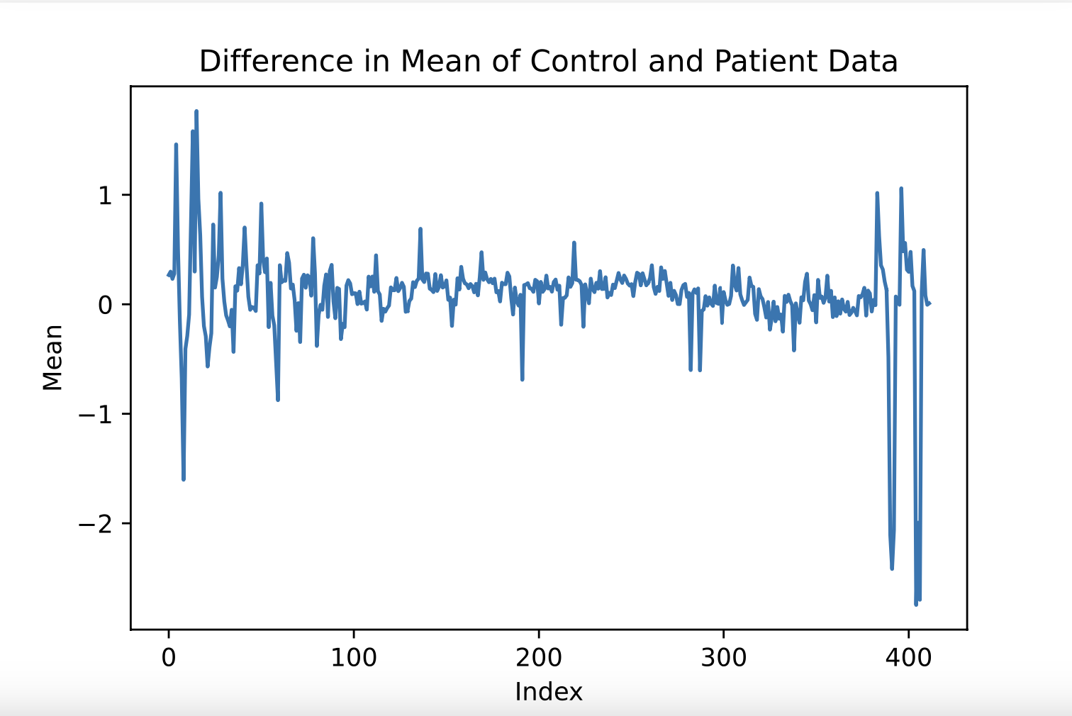
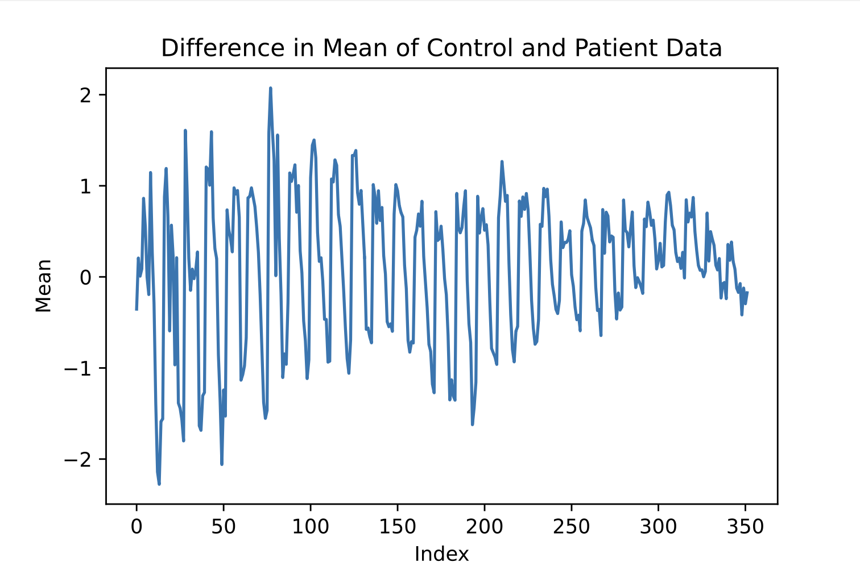
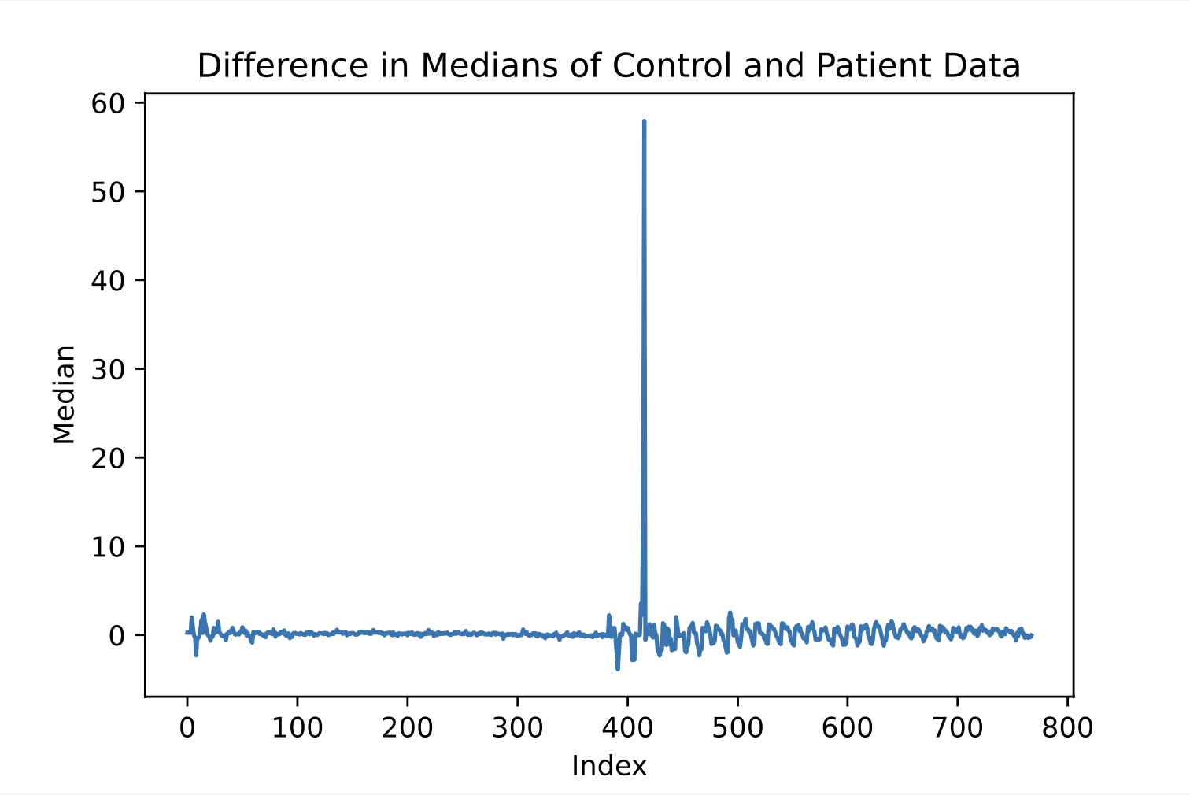
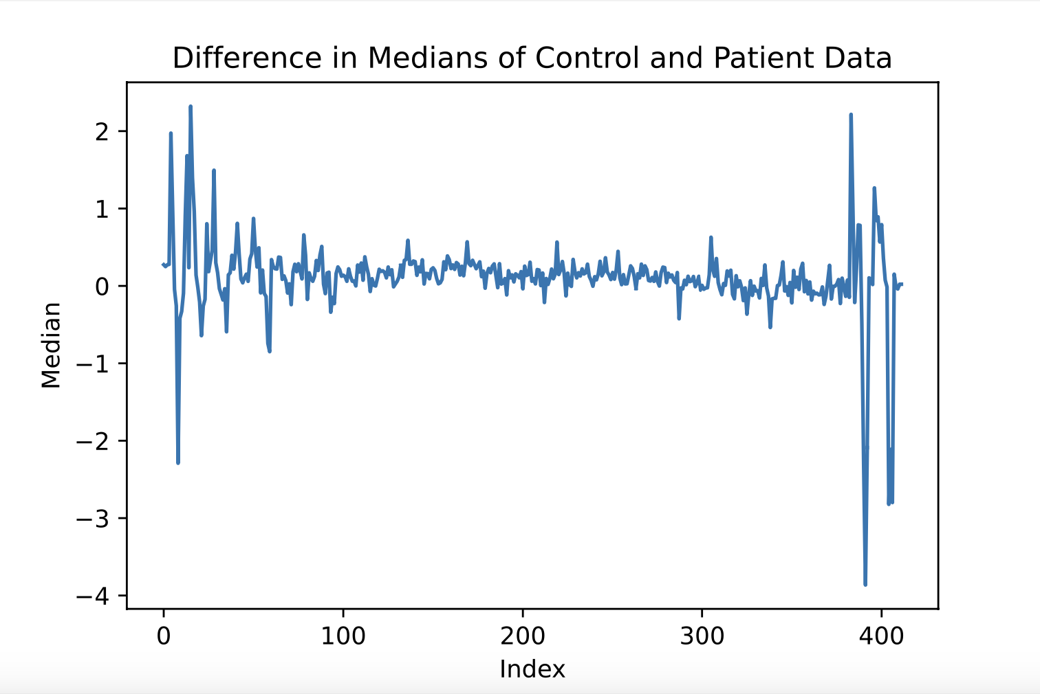
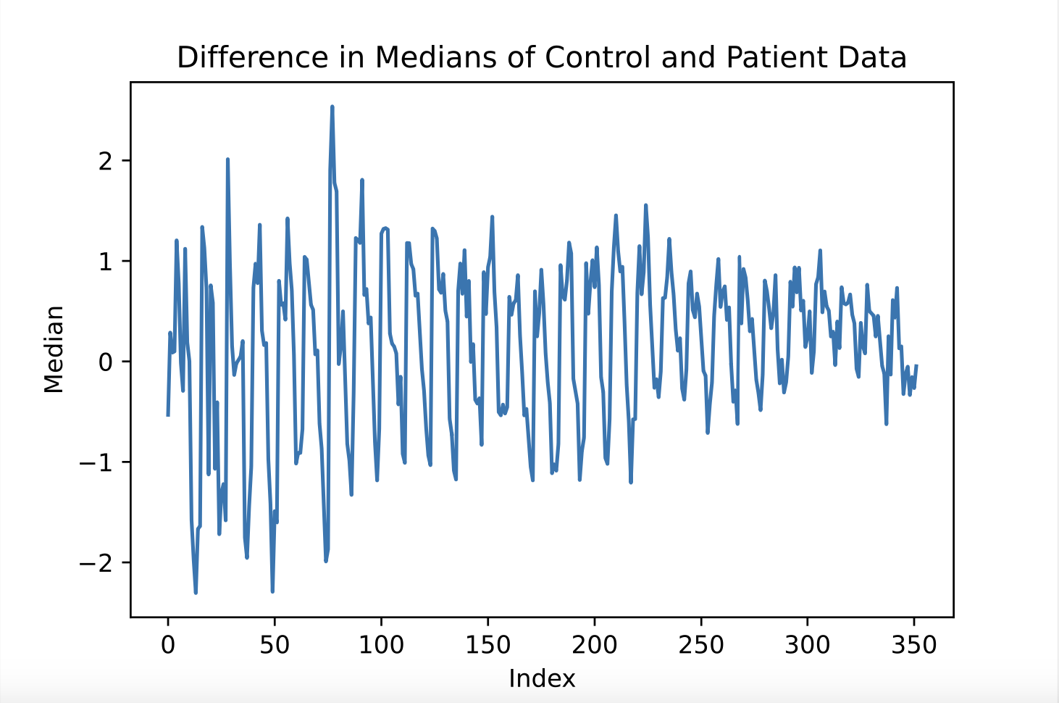
Mean and Variance Visualizations

Slide 9
Reasoning for Models
We removed any pathways that had a difference in the control and patient medians between -0.2 and 0.2, leaving us with 452 wells. This was to ignore wells that didn’t show any difference between patients and controls and prevent overfitting.
We used Logistic Regression models and decision trees because our ultimate goal is to do binary classification for our data (whether or not a person has PMS).
We took predictions on our test split and compared it to the actual values, noting the proportion of values that were incorrectly predicted
We decided to manipulate the amount of features we dropped based on the difference in medians and noticed that in all of these cases, the results stayed in the same area, around .79 - .85
We performed these models with Manganese Chloride and without to compare results.

Slide 10
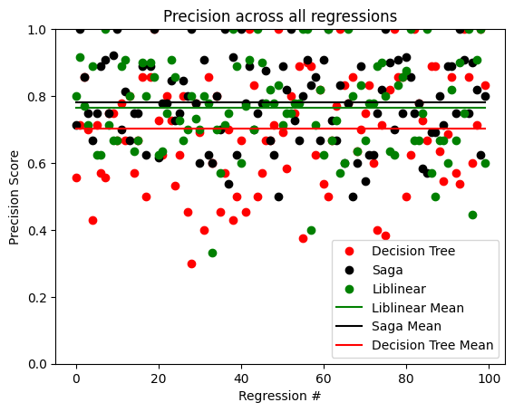
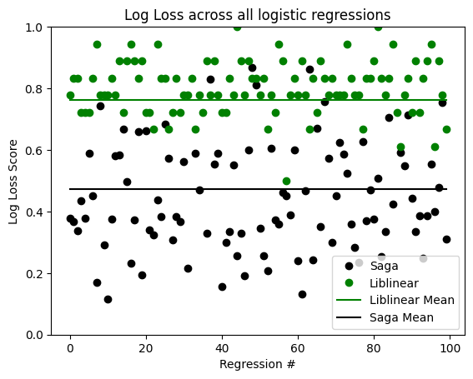
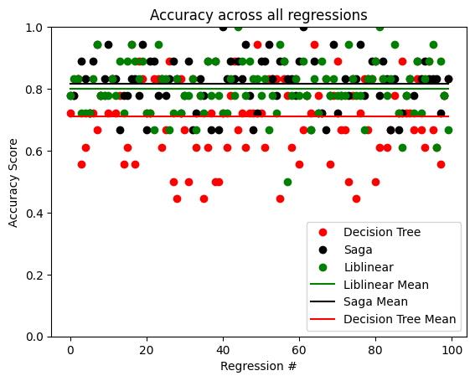
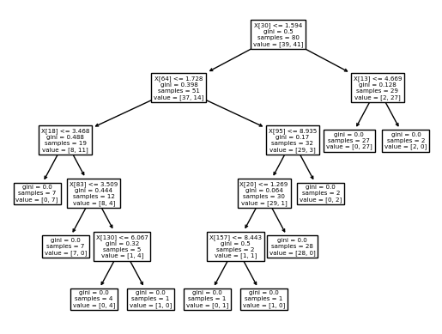
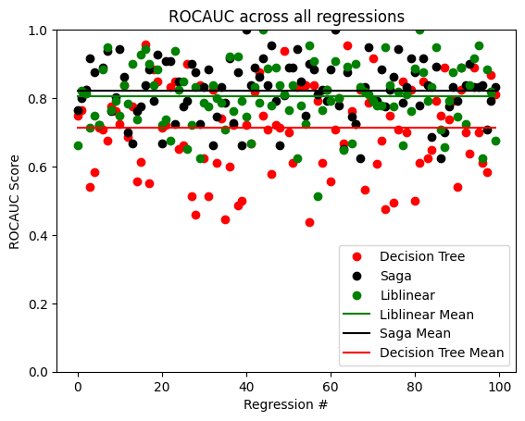
Models & Evaluations

Slide 11
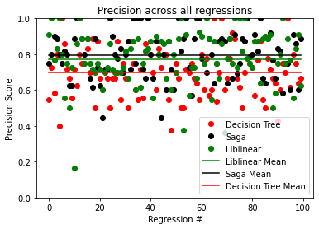
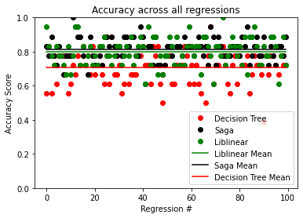
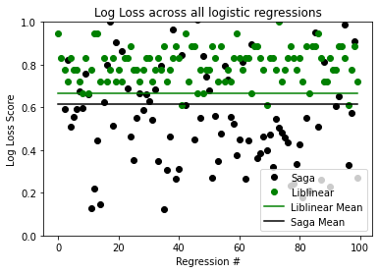
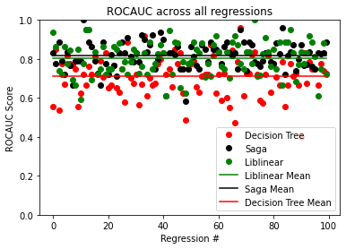
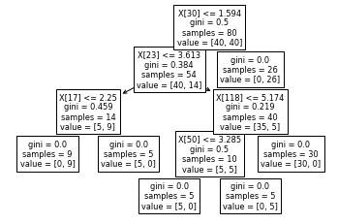
Models and Evaluations Without Manganese Chloride

Slide 12
QUESTIONS?

